Slide 1
Collaborative Research Discussion on “UAV-based GAN-aided Post Disaster 3D-Scene Reconstruction for Efficient Survivor Detection”
Members: 1) Abhishek Manoharan 2) Nishanthini S 3) Vamsi Raju M 4) Selvam Essaky 5) Gunasekaran Raja 6) Harun Sijak
17.03.2023

Slide 2
outline
SLIDE NAME | SLIDE NO.
Problem Statement | 3
Objectives | 4
References | 5
Limitations of Existing Systems | 6
Proposed Methodology | 8
System Architecture | 11
List of Tools/Frameworks | 12
Expected Outcomes | 13
Timeline | 14
Target Venue | 15
Appendix | 16

Slide 3
PROBLEM STATEMENT
The use of UAVs provides an efficient method to complete the task of scene understanding.
However, complex environments present in post-disaster scenarios make it difficult for UAVs to detect survivors accurately due to the occlusion of humans and a large number of entities present in the image.
To mitigate these issues, we propose an Unmanned Aerial Vehicle (UAV)-based scene understanding framework involving a Generative Adversarial Network (GAN)-aided 3D reconstruction mechanism.

Slide 4
objectives
To develop an efficient post-disaster scene understanding framework using UAVs for survivor detection and Search and Rescue (SAR) operations.
To deploy a GAN framework to improve the detection of survivors, who are generally present as small and dense objects in post-disaster UAV images.
To devise a 3D scene-reconstruction mechanism based on the Structure from Motion (SFM) and Bundle Adjustment algorithms to map and extract useful information from the scene.
To deploy a semantic segmentation mechanism on the 3D model, leading to a pixel-level prediction of various entities in the 3D model, and a hybrid single-stage and multi-stage ensemble network for survivor detection on the color-coded semantic entities.

Slide 5
REFERENCES
J. Dong, K. Ota and M. Dong, "UAV-Based Real-Time Survivor Detection System in Post-Disaster Search and Rescue Operations" in IEEE Journal on Miniaturization for Air and Space Systems, vol. 2, no. 4, pp. 209-219, 2021.
H. Ren et al., "Swarm UAV SAR for 3-D Imaging: System Analysis and Sensing Matrix Design" in IEEE Transactions on Geoscience and Remote Sensing, vol. 60, pp. 1-16, 2022.
T. C. Bybee and S. E. Budge, "Method for 3-D Scene Reconstruction Using Fused LiDAR and Imagery From a Texel Camera" in IEEE Transactions on Geoscience and Remote Sensing, vol. 57, no. 11, pp. 8879-8889, Nov. 2019.
Albaba, Berat Mert, and Sedat Ozer, "SyNet: An ensemble network for object detection in UAV images" in 25th IEEE International Conference on Pattern Recognition (ICPR), pp. 10227-10234, 2021.
Rahnemoonfar, Maryam, Tashnim Chowdhury, and Robin Murphy. "RescueNet: A High-Resolution Post Disaster UAV Dataset for Semantic Segmentation" UMBC Student Collection, 2021.

Slide 6
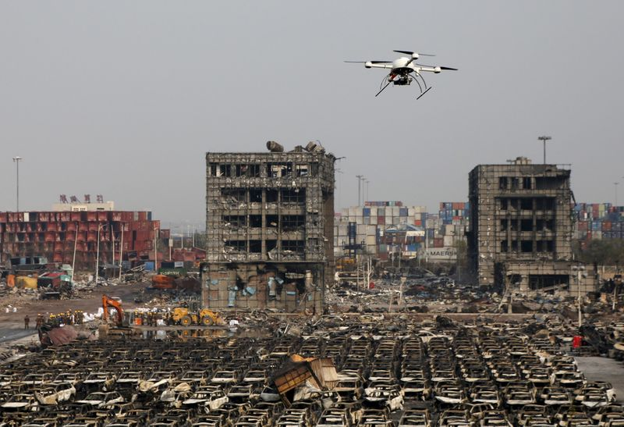
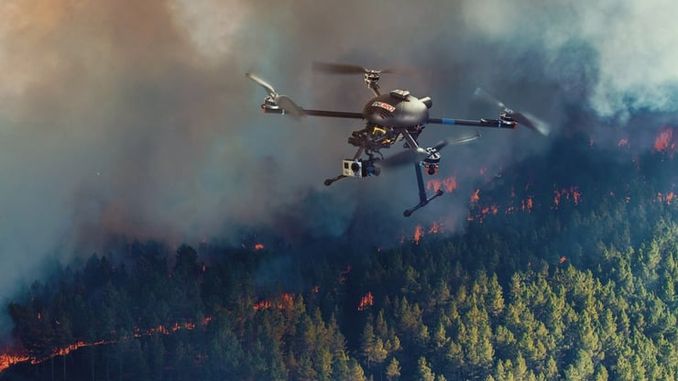
Limitations of existing systems
Post disaster scenes being analysed by a UAV
Post-disaster scene understanding frameworks are becoming increasingly crucial in SAR operations and damage assessment initiatives, and UAVs are becoming an integral part of the systems being deployed for SAR.
However, complex environments present in post-disaster scenarios make it difficult for UAVs to detect humans or objects accurately.
Moreover, inefficient object detection mechanisms lead to low accuracy and a large amount of time for object detection tasks.
Survivors being small objects in post disaster, UAV images make the task of survivor detection using traditional techniques daunting.
Furthermore, survivors who are occluded in the image due to debris or damaged buildings covering them will make the survivor detection task challenging.

Slide 7
Proposed methodology
A GAN-based denoiser results in images having lower occlusion and optimal brightness, thereby highlighting the important features of the object. Furthermore, using GAN improves the detection of small and dense objects, which is the case of survivors in images obtained from a UAV.
The proposed system implements a GAN-infused SFM-enabled 3D reconstruction mechanism to detect survivors present in a post-disaster scene.
A 3D reconstruction of the scene using the enhanced images obtained from the GAN-based model will be used to map and extract useful information.
To overcome the challenge of detecting occluded survivors, we propose a GAN-based generative SFM framework, wherein occluded survivors will be visually generated before the point cloud is triangulated.
The Bundle Adjustment technique is to be deployed to estimate the UAV camera poses with minimal error or drift while generating the 3D model.

Slide 8
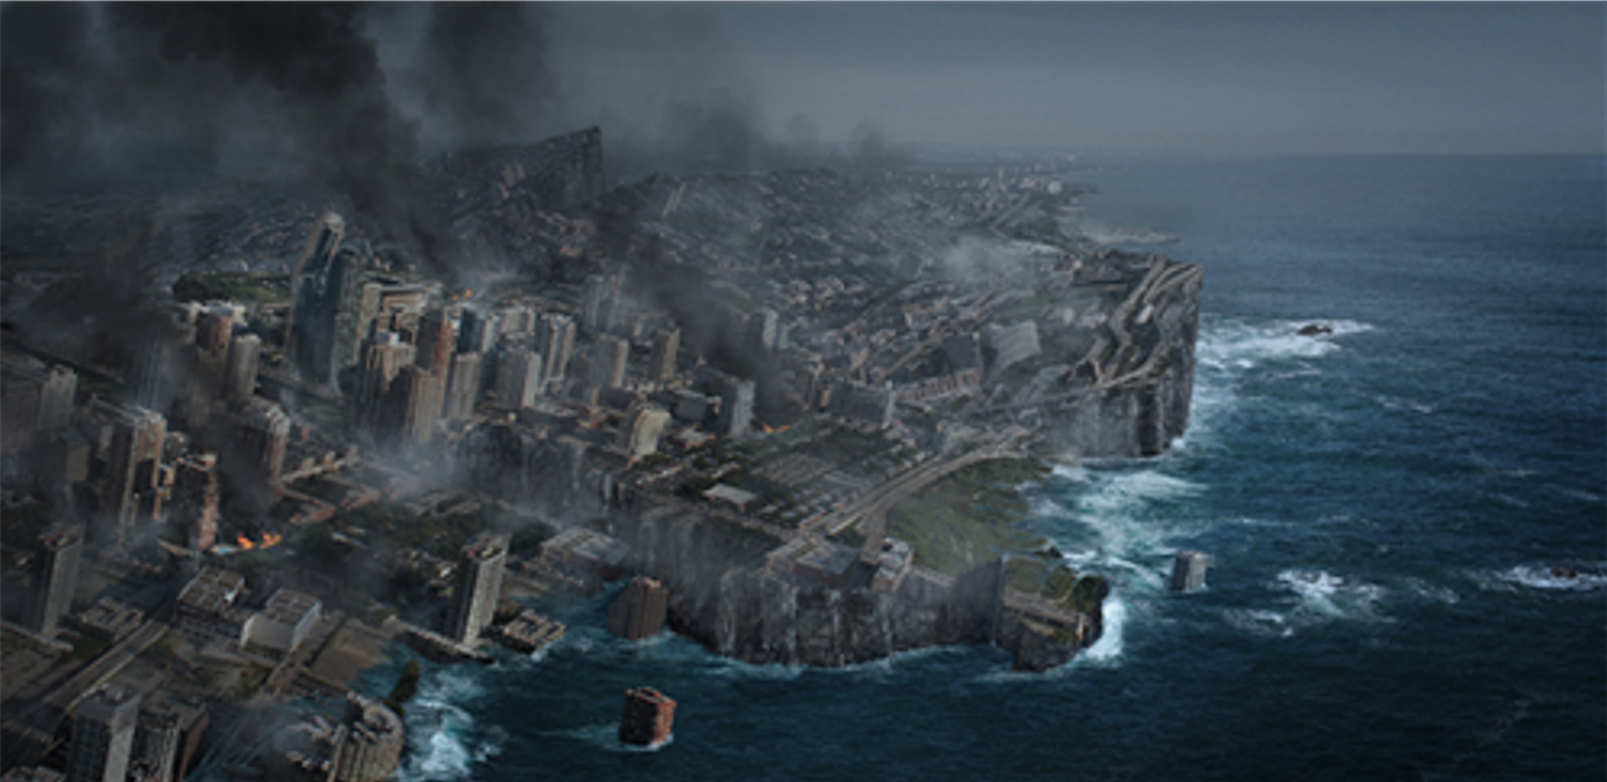
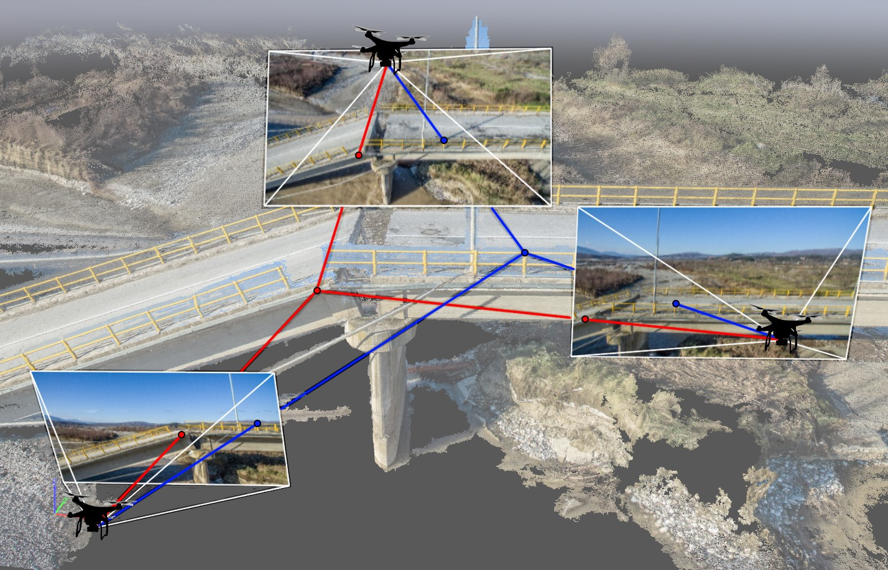
Proposed methodology (cont.)
Semantic segmentation on the 3D model leads to a pixel-level prediction of various entities or objects present in the image, thereby generating a corresponding color-coding to each entity.
The ensemble model, a hybrid architecture consisting of single-stage and multi-stage detectors, is to be implemented to detect the presence of survivors. The network will overcome the disadvantages of both frameworks.
Deploying an ensemble network comprising the CenterNet and Cascade R-CNN frameworks improves the performance of survivor detection while decreasing the false negative rate.
The overall framework will increase the accuracy and efficiency of the survivor detection task, thereby resulting in successful SAR operations.
3D model of a post-disaster scene
Structure-From-Motion using UAVs

Slide 9
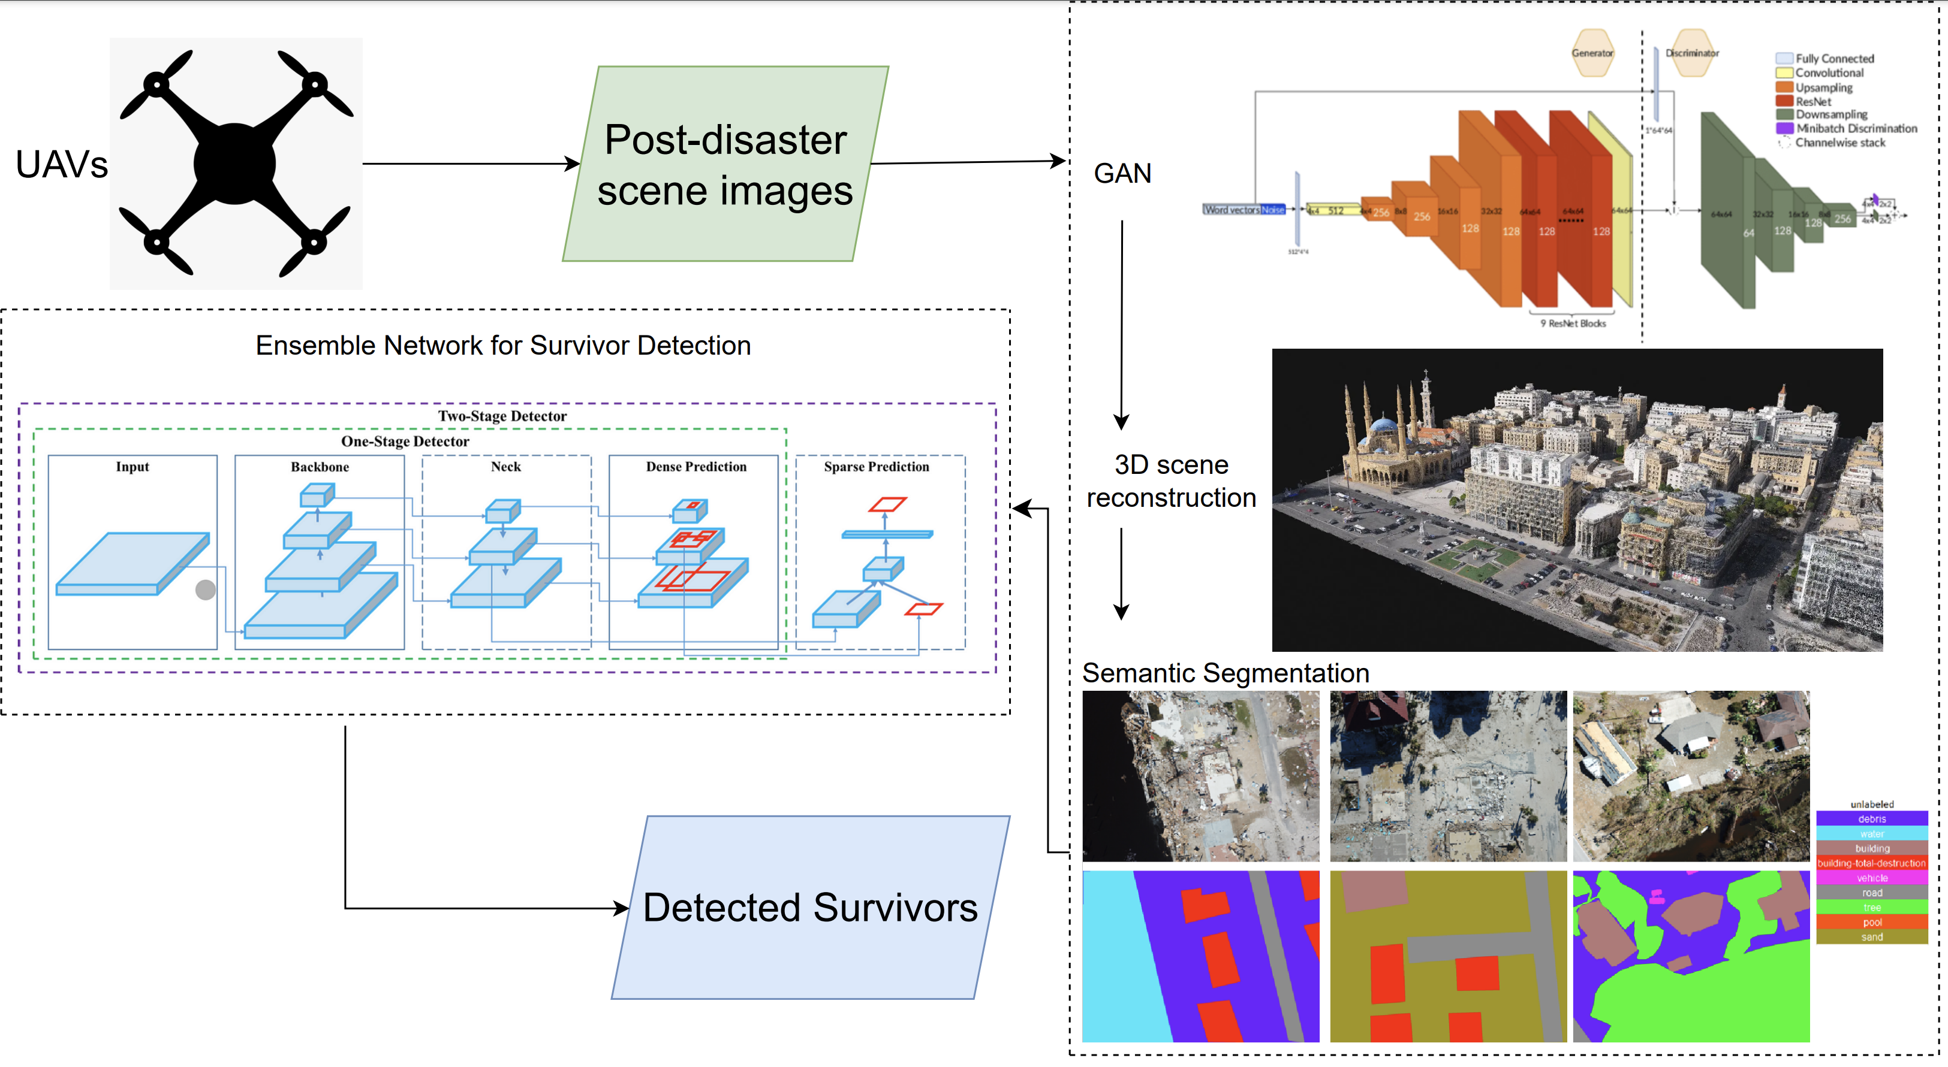
SYSTEM ARCHITECTURE
Figure: High level architecture diagram

Slide 10
list of tools/Frameworks Engaged
PyTorch
Torchvision
OpenCV Python
Matplotlib
Meshlab
CUDA
LabelImg

Slide 11
EXPECTED OUTCOMES
An efficient post-disaster scene understanding framework using UAVs for survivor detection and SAR operations will be developed, encompassing:
A GAN-based denoiser and occlusion remover mechanism will be implemented to improve the detection of survivors using post-disaster UAV images.
A 3D scene-reconstruction mechanism based on the SfM and Bundle Adjustment algorithms will be executed to map and extract the most useful information present in the scene
A semantic segmentation mechanism will be deployed on the 3D model to classify various entities in the scene, thereby improving survivor detection.
A hybrid ensemble network comprising single-stage and multi-stage detectors will be developed for survivor detection using the color coding and classification of semantic entities. This will result in the decrease of the high false negative rate of the multi-stage mechanism and the improvement in the performance of the single-stage detector.

Slide 12
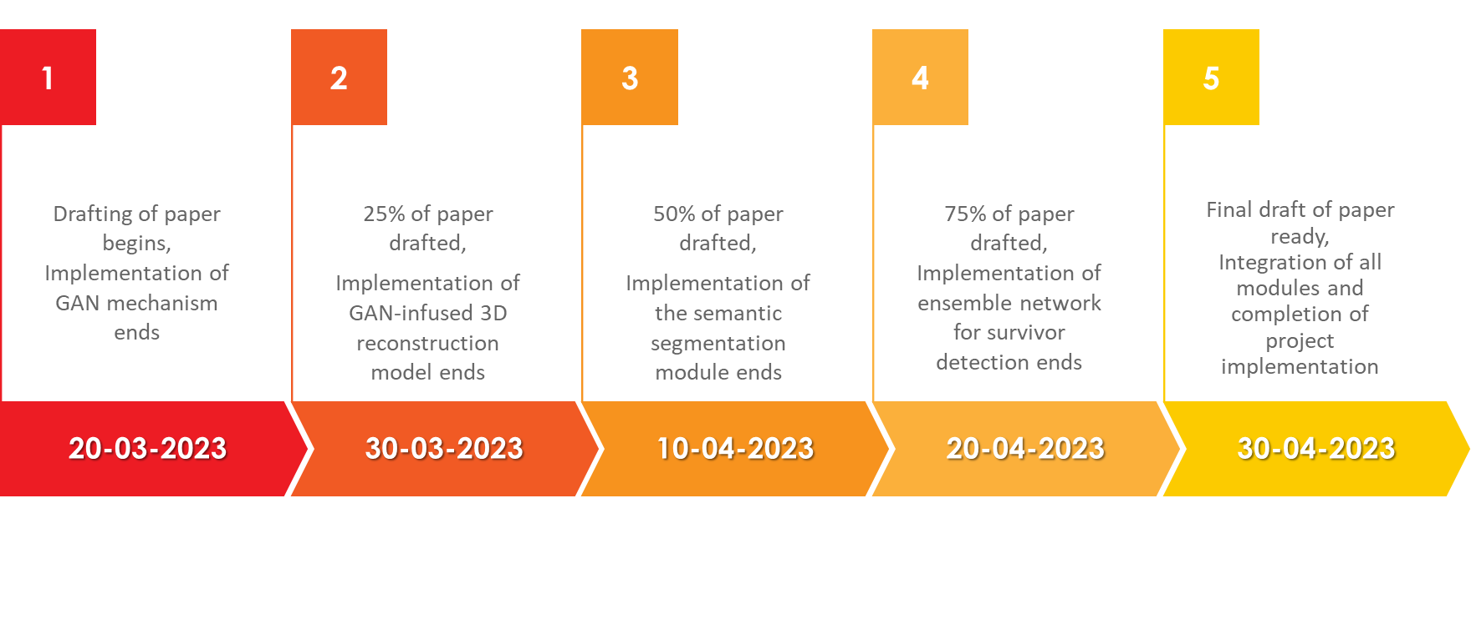
timeline

Slide 13

Target venue

Slide 14
Appendix LITERATURE SURVEY
S.No | Publication Venue and Year | Title | Proposed Work | Limitations
1. | IEEE Journal on Miniaturization for Air and Space Systems, vol. 2, no. 4, pp. 209-219 (2021) | UAV-Based Real-Time Survivor Detection System in Post-Disaster Search and Rescue Operations | This paper proposes a new thermal image dataset consisting of 6447 thermal images designed for survivor detection using UAVs in post-disaster scenarios. The paper also describes optimal values to prune survivor detection models in order to reduce the complexity of the models. The model applies knowledge distillation techniques to fine-tune them and improve accuracy. The performance of several survivor detection models based on YOLOv3 and YOLOv3-MobileNetV1 were compared with and without pruning and fine-tuning. | Older and inferior detection models have been used for survivor detection, thereby resulting in models with high mean average precision (mAP) loss and low accuracy.

Slide 15
Appendix LITERATURE SURVEY
S.No | Publication Venue and Year | Title | Proposed Work | Limitations
2. | IEEE Transactions on Geoscience and Remote Sensing, vol. 60, pp. 1-16 (2022) | Swarm UAV SAR for 3-D Imaging | This paper implements a 3D imaging mechanism for 2D images obtained from a swarm of UAVs. The proposed work involves the 3D imaging of a scene by the usage of 2D images obtained from several UAVs present in the UAV Swarm at different perspectives with a few points of overlap. The point cloud obtained is then triangulated, and Bundle Adjustment is used to create the 3D rendering of the image. | A considerable amount of data must be transmitted from the UAV swarm, as images obtained from each node in the swarm are used to produce the 3D rendering. Multiple UAVs also need to exchange information in order to efficiently collect data of the scenario.

Slide 16
Appendix LITERATURE SURVEY
S.No | Publication Venue and Year | Title | Proposed Work | Limitations
3. | IEEE Transactions on Geoscience and Remote Sensing, vol. 57, no. 11, pp. 8879-8889 (2019) | Method for 3-D Scene Reconstruction Using Fused LiDAR and Imagery From a Texel Camera | In order to create greater fidelity terrain models, this study describes a bundle adjustment technique for aerial texel images. The model enables relatively low-accuracy navigation systems to be employed with inexpensive LiDAR and camera data. | Outliers present in the point cloud are not identified and mitigated, thereby leading to lower accuracy.

Slide 17
Appendix LITERATURE SURVEY
S.No | Publication Venue and Year | Title | Proposed Work | Limitations
4. | 25th IEEE International Conference on Pattern Recognition (ICPR), pp. 10227-10234 (2021) | SyNet: An ensemble network for object detection in UAV images | With the goal of lowering the high false negative rate of multi-stage detectors and improving the quality of the single-stage detector proposals, the authors of this research propose an ensemble network called SyNet that combines a multi-stage method with a single-stage one. | According to the investigation, detecting objects in drone images is more challenging than detecting them in images that were taken from the ground, even with the most advanced object detection algorithms. Hence, the accuracy of the model trained on UAV images is still low compared to models trained on ground images.

Slide 18
Appendix LITERATURE SURVEY
S.No | Publication Venue and Year | Title | Proposed Work | Limitations
5. | IEEE Transactions on Neural Networks and Learning Systems, vol. 33, no. 11, pp. 6047-6067 (2022) | Vehicle Detection From UAV Imagery With Deep Learning | The article provides a review of vehicle detection from UAV imagery using deep learning techniques. It begins by outlining the various deep learning architectures, including generative adversarial networks autoencoders recurrent neural networks convolutional neural networks and their contributions to the challenge of improving vehicle detection. The paper then focuses on examining various vehicle detection techniques and presents different benchmark datasets and problems that have been discovered, along with possible remedies. | Videos captured in the UAVs are sent to on-ground workstations or to the cloud for processing rather than being implemented on the UAV itself, thereby leading to the absence of a lightweight system for vehicle detection

Slide 19
Appendix LITERATURE SURVEY
S.No | Publication Venue and Year | Title | Proposed Work | Limitations
6. | IEEE Transactions on Instrumentation and Measurement, vol. 71, pp. 1-13 (2022) | Dense and Small Object Detection in UAV-Vision Based on a Global-Local Feature Enhanced Network | This paper proposes a global-local feature-enhanced network (GLF-Net) to alleviate issues when detecting small and dense objects using UAVs. A feature-fusion module has been proposed to tackle the presence of numerous small objects. GLF-Net achieves 86.52% mean Average Precision (mAP) on the RO-UAV dataset. | The scalability of the framework is poor, and the application of GLF-Net on post-disaster UAV images leads to lower mAP, thereby requiring better frameworks.

Slide 20
Appendix LITERATURE SURVEY
S.No | Publication Venue and Year | Title | Proposed Work | Limitations
7. | IEEE/CVF International Conference on Computer Vision (ICCV), pp. 1223-1232 (2021) | Unmanned aerial vehicle visual detection and tracking using deep neural networks: A performance benchmark | This paper executes and compares various UAV detection mechanisms using air-borne UAVs that deploy deep neural networks. 4 datasets have been used and performance has been compared, namely MAV-VID, Drone-vs-Bird, Anti-UAV RGB, and Anti-UAV IR. The performance of 4 models was compared using the datasets mentioned, namely Faster RCNN, SSD512, YOLOv3, and DETR (Detection Transformer). Overall, Faster RCNN performed best. | Long-distance detection of small UAVs was not taken into consideration. Deep neural networks for re-identification of UAVs were not considered as well.

Slide 21
Appendix LITERATURE SURVEY
S.No | Publication Venue and Year | Title | Proposed Work | Limitations
8. | UMBC Student Collection (2021) | RescueNet: A High-Resolution Post Disaster UAV Dataset for Semantic Segmentation | This paper introduces a high-resolution post-disaster UAV dataset named RescueNet, which contains comprehensive pixel-level annotation of 11 classes for semantic segmentation to assess damage after a natural disaster. The dataset collection and annotation process are discussed, along with the challenges it poses. | RescueNet contains a small number of classes. As a result, smaller objects like “vehicles” and “pools” make it difficult to get a good segmentation compared to larger objects like buildings and roads. Besides that, since UAV images include only the top view of a scene, it is difficult to assess the actual damage since the horizontal view also brings information regarding all sides of a building.

Slide 22
Appendix LITERATURE SURVEY
S.No | Publication Venue and Year | Title | Proposed Work | Limitations
9. | IEEE/CVF Conference on Computer Vision and Pattern Recognition (CVPR), pp. 16266-16275 (2021) | Uav-human: A large benchmark for human behavior understanding with unmanned aerial vehicles | This paper proposes a UAV-Human dataset for human action, pose, and behavior understanding. The proposed UAV-Human contains 67,428 multi-modal video sequences 119 subjects for action recognition 22,476 frames for pose estimation 41,290 frames 1,144 identities for person re-identification 22,263 frames for attribute recognition which encourages the exploration and deployment of various data-intensive learning models for UAV-based human behavior understanding. | The UAV-Human dataset poses a limitation for attribute recognition because the dataset is captured over a relatively long period of time. As a result, the subjects have been diversified with different dressing types and large variations of viewpoints caused by multiple UAV altitudes.

Slide 23
Appendix LITERATURE SURVEY
S.No | Publication Venue and Year | Title | Proposed Work | Limitations
10. | 2021 IEEE International Geoscience and Remote Sensing Symposium IGARSS, pp. 2325-2328 (2021) | Attention-Based Semantic Segmentation on UAV Dataset for Natural Disaster Damage Assessment | This paper proposes and evaluates a novel self-attention segmentation model named ReDNet on a new high-resolution UAV natural disaster dataset named HRUD. The challenges of semantic segmentation on the HRUD dataset are discussed, along with the excellent performance of the proposed model. | HRUD is a very challenging dataset due to its variable-sized classes along with similar textures among different classes. Debris, textures of debris, sand, and building with destruction damage make a great impact on the segmentation performance of the evaluated network models.

Slide 24
THANK YOU

